Slide 1
British Airways
Predictive model to understand factors that influence buying behavior
2022-11-09

Slide 2
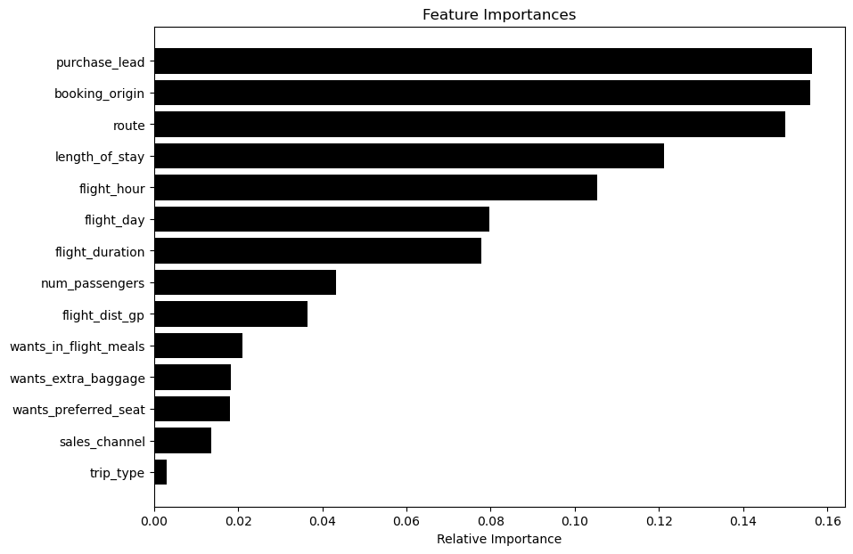
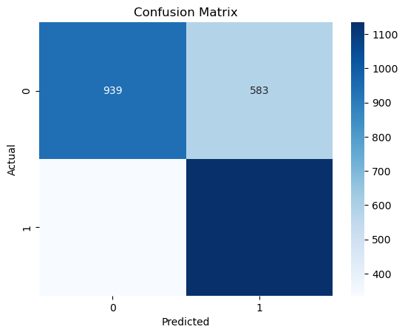
Key metrics
Total bookings data collected
50000
Complete bookings
42522
Incomplete bookings
7478
Top factor
Purchase lead
We analyzed data using a Random Forest Classifier model to identify factors influencing booking completion.
The model achieved an accuracy of 70%, indicating its ability to predict booking trends.
key factors with positive correlations to booking completion: Number of Passengers, Trip Type (Round trip bookings), Purchase Lead Time, Length of Stay.
Recommendations based on these insights:
Targeted Promotions and Dynamic Pricing
Early Bird Discounts
Package Deals
Flight Schedule Optimization
By implementing these data-driven strategies, we can improve booking completion rates, optimize revenue, and enhance the overall customer experience.

